Slide 1
IR 101 Metrics Quality Assurance
@juju43, Defcon 31, Aug 2023
Notes:
Last updated: 2023/05/14

Slide 2
Intro
Metrics are a requirement to evaluate impact and make improvements over incidents
Those should help to identify easily which risk, platform or component is most often at stake and where improvements are more valuable.
Often ignored or feared by individual contributor

Slide 3
Recommendations
Make it easy
Make it automatable
Tell a story
Allow to get more context
Fit for audience
Operations, Tactical
Management, Strategic

Slide 4
Common metrics
Number of incidents per severity, per hour of day or day of week, per application/platform or geography
Mean-Time-To-Acknowledge
Mean-Time-To-Repair (MTTR) or Contain or Fix, Cost of repair (hours)
Mean-Time-Between-Failure (MTBF)
Availability: either as uptime, either as successful requests (if using Error budget)
Error budget (Google Site Reliability Engineering): one minus the availability target

Slide 5
More SOC/IR metrics
Dwell time: time between cause of incident/compromission and discovery
Kill Chain, MITRE ATT&CK
Outcome: false-positive, true-positive, duplicate...
Identified loss, money, time, staff involved, systems rebuilt, external communication
Source of notification: automated system, manual, 3rd party
Controls involved

Slide 6
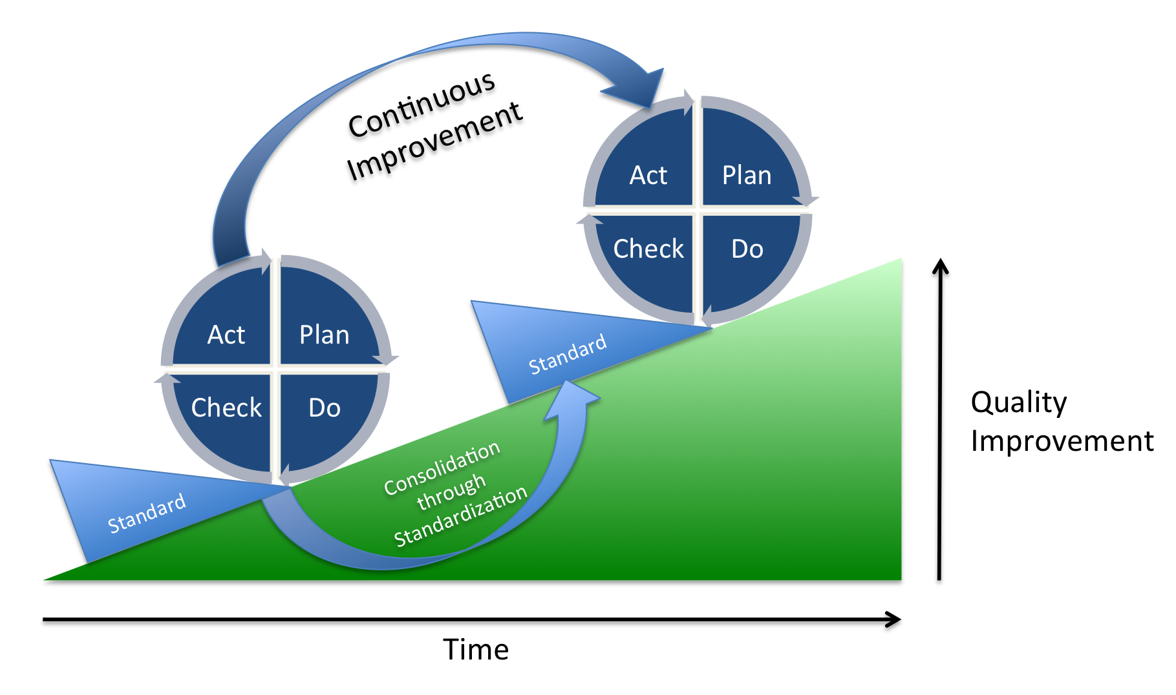
Check aka Quality Assurance
Shewhart or Deming Wheel, ISO9001 and others
Plan-Do-*Check*-Act or PDCA
Notes:
https://en.wikipedia.org/wiki/PDCA#/media/File:PDCA_Process.png

Slide 7
Check (2)
Peer review and dual control are critical in security.
Make it easy: random selection, google/o365 short form for quick evaluation
Appropriate handling, good communication, lessons learned...
Share back: in ticketing, in team chat, to analyst, to management...
Notes:
+ How'd we get there? Story in /threadHow do you measure #SOC quality? 🤔
1. ISO 2859-1 (#AQL) to determine sample size
2. #Python #Jupyter notebook to perform random selection
3. Check sheet to spot defects
4. Process runs every 24 hrs
5. (Digestible) #Metrics to improve
How'd we get there? Story in /thread
https://twitter.com/jhencinski/status/1254465280367083521

Slide 8
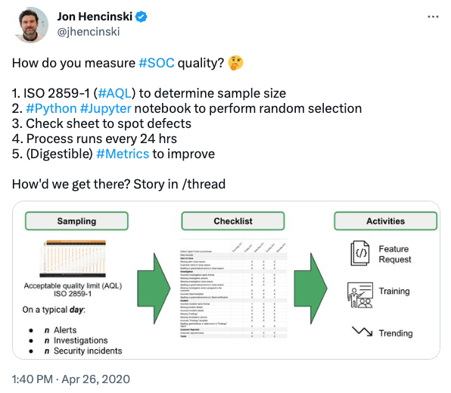
Summary
Don’t assume, Verify
Sample
Automate
Communicate
Show value with less bias
Notes:
[1. Never stop learning.2. See failure as a beginning.3. Teach others what you know.4. Assume nothing, question everything.5. Analyze objectively.6. Practice humility.7. Respect constructive criticism.8. Love what you do.9. Give credit where it's due.10. Take initiative. Feb 2023](https://twitter.com/ProfFeynman/status/1627127271671861249)

Slide 10
References - Methodologies
Vocabulary for Event Recording and Incident Sharing (VERIS)
Error Budgets and Risks, Marc Alvidrez, Google, SRECon 2015
Computer Security Incident Handling Guide SP800-61r2, NIST: 3.4.2 Using Collected Incident Data
Using Metrics to Mature Incident Response Capabilities, Mandiant, 2014 – DRAIN CVR
ETSI GS ISI 003 V1.2.1 (2018-01) Information Security Indicators (ISI); Key Performance Security Indicators (KPSI) to evaluate the maturity of security event detection
SEF-05: Incident Response Metrics, CSA Cloud Controls Matrix
Lessons learned from the Microsoft SOC, Part 1: Organization, Feb 2019: Time to acknowledge (TTA), Time to remediate (TTR), Incidents remediated (manually/with automation), Escalations between each tier
Use Case Applicability: How to better integrate Continuous Improvement into Security Monitoring, Jun 2019
Notes:
https://en.wikipedia.org/wiki/Five_whys

Slide 11
References (2)
How do you measure #SOC quality? … How'd we get there? Story in /thread, Apr 2020
Hey SOC peeps, if you have to use a SINGLE metric to communicate #SOC value proposition to stakeholders (esp laypeople), what is it and how does it define value? Jul 2020
Performance metrics, part 1: Measuring SOC efficiency, Sep 2020: When do alerts show up? How long do alerts wait? How long does it take to go from alert to fix?
Performance metrics, part 2: Keeping things under control, Oct 2020
How to create (and share) good cybersecurity metrics, Mar 2021
Performance metrics, part 3: Success stories, May 2021
How to measure SOC quality, Jun 2021
11 Strategies of a World-Class Cybersecurity Operations Center, MITRE, Mar 2022: Strategy 10: Measure Performance to Improve Performance, references

Slide 12
References (3)
PDCA (plan–do–check–act or plan–do–check–adjust)
ISO 2859-1:1999 Sampling procedures for inspection by attributes — Part 1: Sampling schemes indexed by acceptance quality limit (AQL) for lot-by-lot inspection

